Slide 1


Slide 2


Slide 3


Slide 4


Slide 5

y

Slide 6
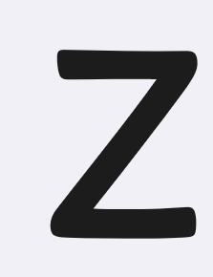

Slide 7


Slide 8
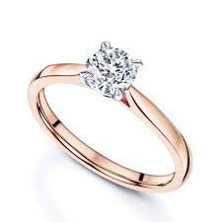
shiny ring
ng

Slide 9
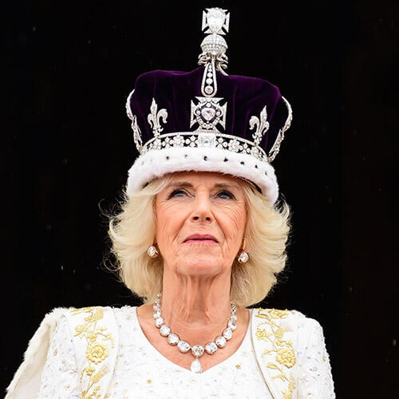
She’s our queen!
qu
qu
She's our queen!

Slide 10
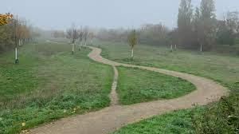
This long path
th

Slide 11

We love to shop!
sh

Slide 12
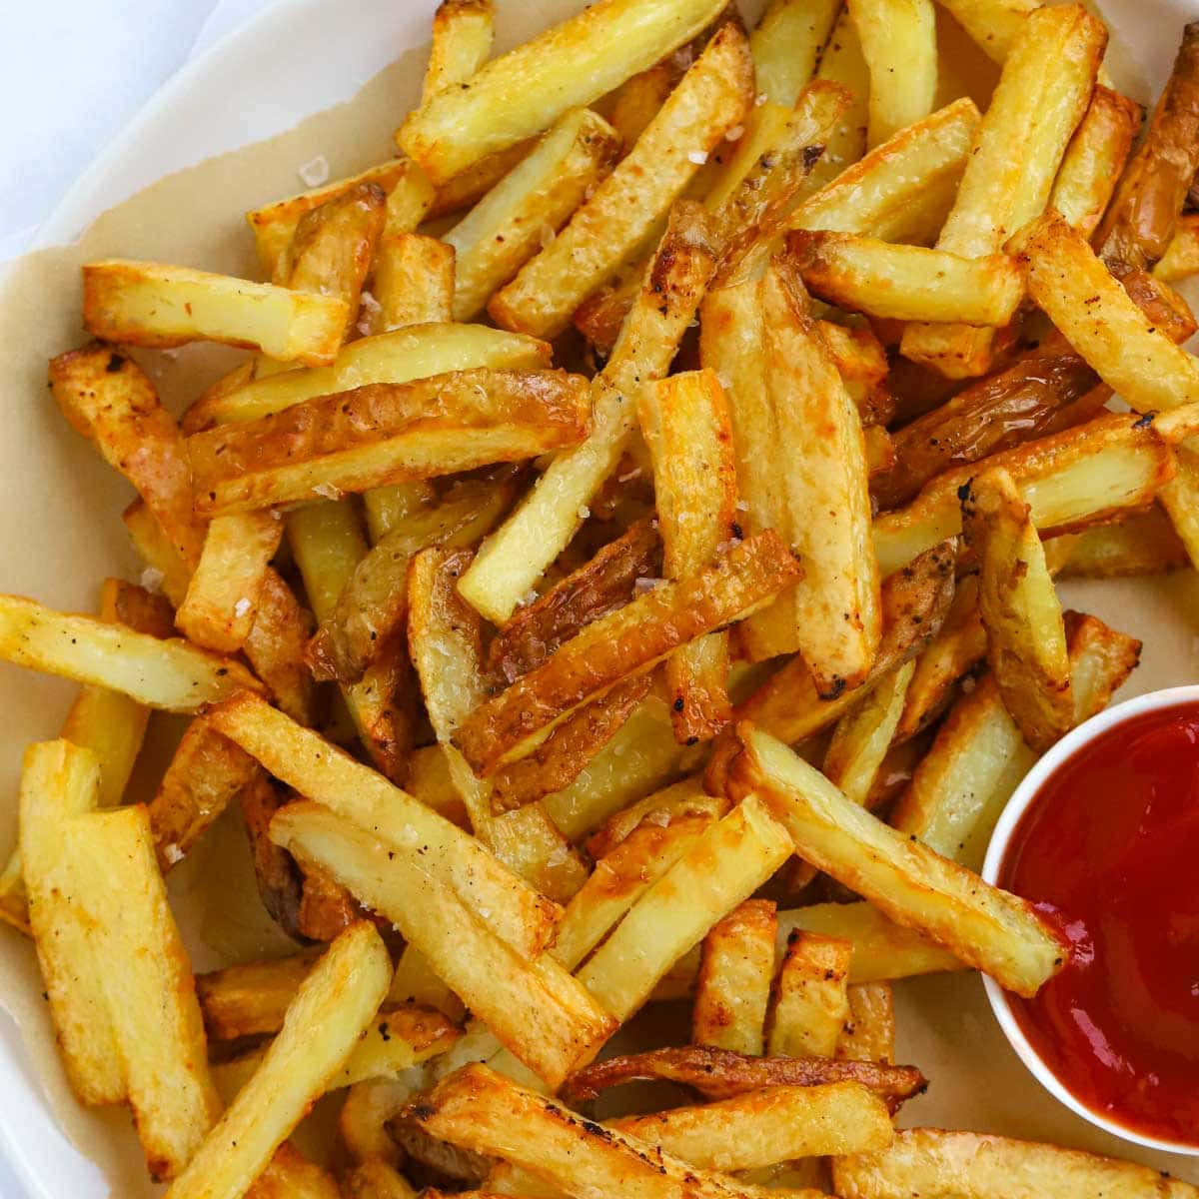
Tasty chips!
ch

Slide 13
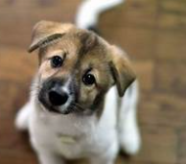
Wag your tail!
ai

Slide 14
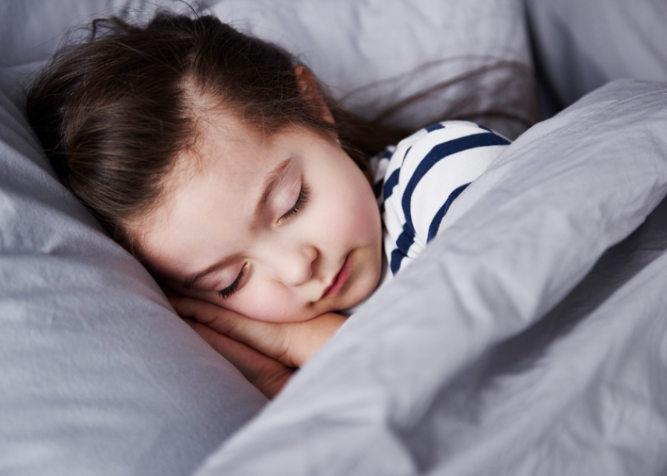
Go to sleep!
ee

Slide 15

Super high!
igh

Slide 16

Oo,
oo,
oo,
Poo!
oo

Slide 17

I can cook!
oo

Slide 18
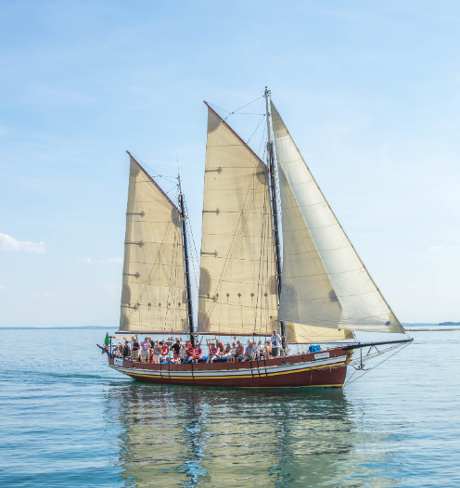
Float in the boat!
oa

Slide 19
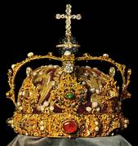
Shiny crown!
ow

Slide 20
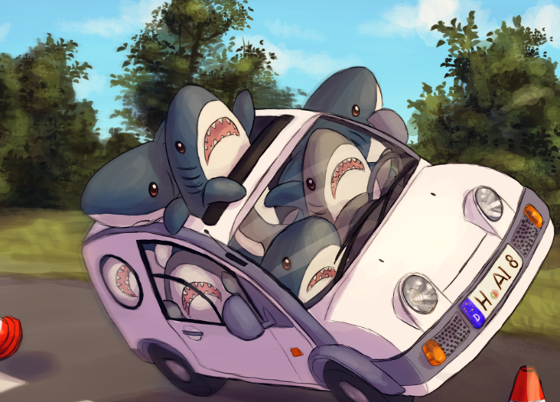
Sharks in the car!
ar

Slide 21
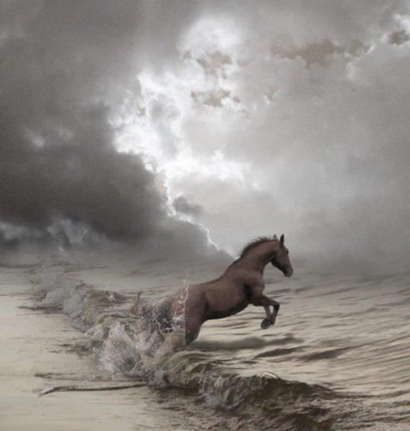
Horse in a storm!
or

Slide 22
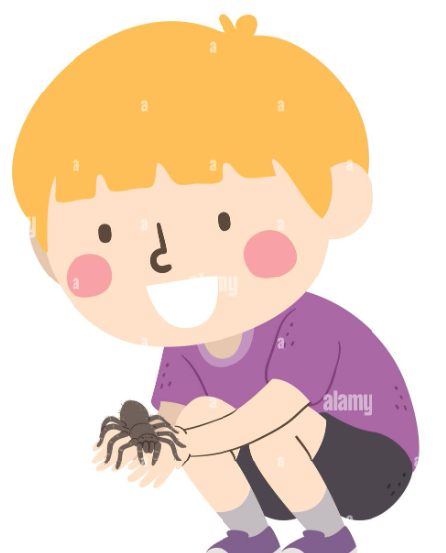
Spider on my finger!
er

Slide 23

Purple church!
ur

Slide 24
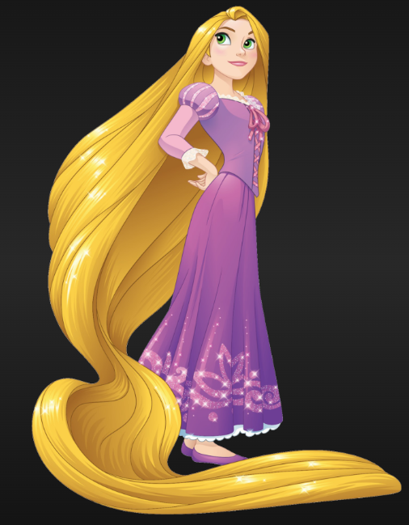
That’s my hair!
air

Slide 25
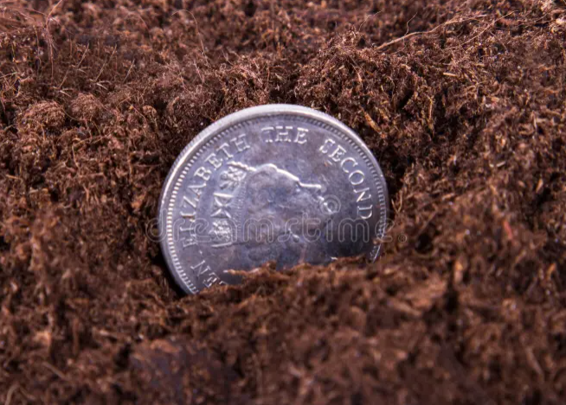
Coin in the soil!
oi

Slide 26
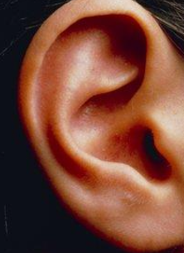
Hear with your ear!
ear

Slide 27


Sure it’s a cure!
ure

